Slide 1
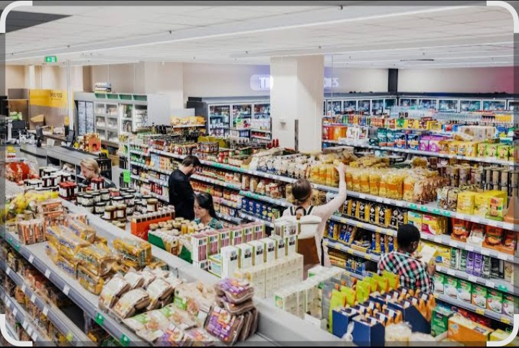
RETAIL SHOP

Slide 2
Table of content
Miro planning …………………………………………….3
SQL explanation ………………………………………….5
Excel dashboard…………………………………………..6
Recommendations ……………………………………10

Slide 3
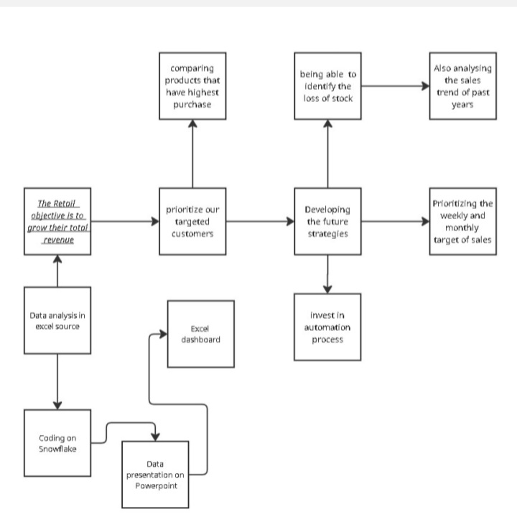
Miro planning

Slide 4
Looking at the above Miro diagram, it shows that as the Retail shop we have objective of growing total revenue but we have to prioritize our marketing strategy by looking our targeted customers, and developing future strategies will lead to more progress also investing in automation process. Therefore Retail`s miro diagram gives a clear direction of meeting their target.

Slide 5
SQL explanation
We used the given data from past years that was stored in our database, now the queries identifies the customer purchasing sequence, products bought the most, time where the shop get full of customers and when we less customers. So this tracks the sales trends month by month to see where we are underperforming.

Slide 6
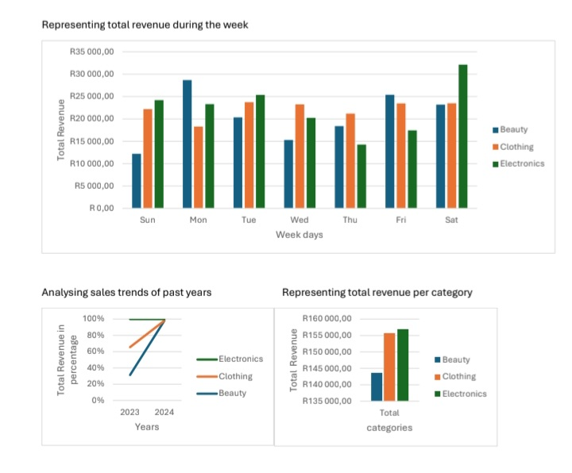
Excel dashboard

Slide 7
Looking at the weekly revenue trend (top chart), the chart shows revenue performance by category across the week. Electronics consistently generates strong revenue, peaking on Monday and Saturday, with Saturday being the highest revenue day overall. Clothing is stable through the week, without large fluctuations – a steady contributor.Beauty shows the lowest revenue contribution, but it still improves significantly Monday.

Slide 8
On year sales trends (bottom left from 2023 to 2024 all three categories have seen positive growth. Electronics shows the highest growth rate nearing 100%. Clothing also grows strongly, but slightly behind the electronics. Beauty showsv growth but from a much smaller base.

Slide 9
Total revenue by category (bottom right) Electronics and Clothing are the top performing categories, generating around R155 000 each. Beauty lags significantly, generating closer to R140 000.

Slide 10
Recommendations
Electronics should remain the a priority investment as it has the strongest weekly and annual performance, especially on weekends.
Clothing provides consistent revenue therefore it maintain steady support, as it balances overall performance.
As Beauty is currently underperforming, but does better on Monday and Friday we have to target promotions ( e.g self care Monday) to capture these peaks also use online campaign to boost brand visibility.

Slide 11
THANK YOU

